Slide 1
Object detection in Point Cloud : Lane Marking
Mohan Jayaprakash – A20405567
Herick Jayesh Asmani – A20399752
Sharanheer Choudhari – A20398615

Slide 2
Motivation
Even though semi-autonomous driving on highways with support of advanced driver assistance systems (ADAS) is almost common, we are still far away from driving autonomous everywhere.
Due to the same moving direction of vehicles, the absence of traffic lights and other traffic participants like pedestrians, the complexity of the autonomous driving task on highways is decreased.
Whereas, in urban areas the amount of possible traffic situations is vast. Although the vehicle speed is much slower when compared to expressways, the visual range is reduced as well.
Often blocked by objects like cars, trucks, fences or houses, traffic participants can not be sure to detect obstacles early enough.
Based on this, autonomous vehicles are equipped with different kinds of sensors for various tasks, including the obstacle detection.

Slide 3
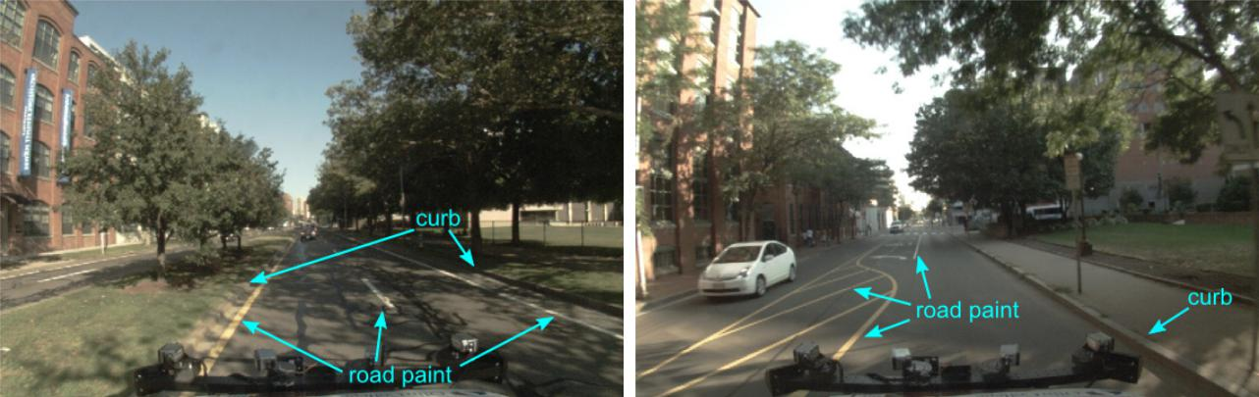
Motivation
The primary goal of a lane estimation algorithm is to estimate the curves representing the lanes of interest, using available sensor data, and to update these estimates over time as the vehicle observes new parts of the roadway.
A system able to automatically and reliably estimate the roadway and its lanes from a moving vehicle using on-board sensor data would have enormous benefits for land-based travel.
It could be used for tasks ranging from wide-scale road and lane quality assessment, to providing inputs to a driver assistance safety or navigation system, to serving as a situational awareness component in a fully autonomous vehicle.

Slide 4
Point Cloud
Point clouds are usually created by 3D scanners, is a set of data points intended to represent the external surface of an object.
A 3D scanner is a device that analyses a real-world object or environment to collect data on its shape and possibly its appearance (e.g. colour). The collected data can then be used to construct digital three-dimensional models.
3D scanners like LIDAR are used to detect the point cloud data like intensity .
In our case we have a point cloud file with 4,30,736 point defined as
[latitude] [longitude] [altitude] [intensity]
45.90388 11.028413 232.4648 10
45.90368 11.028220 234.4706 5

Slide 5
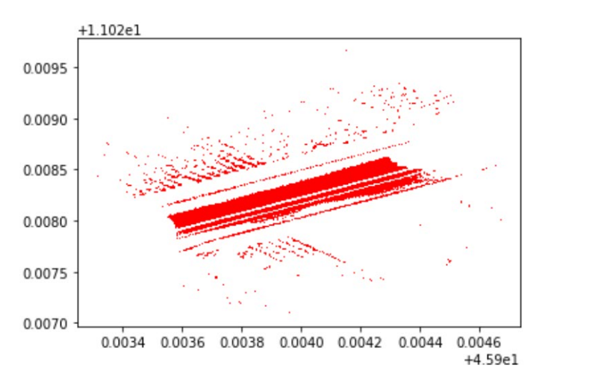
Approach
Filter points about latitude and longitude with intensity.
Points with intensity levels greater than or equal 0:

Slide 6
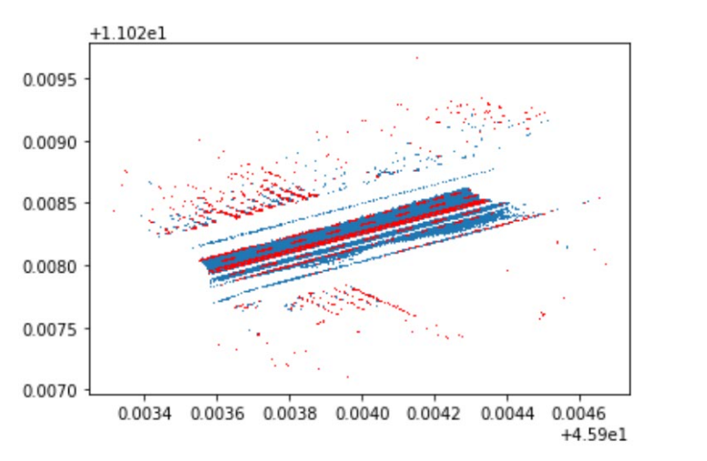
Approach
Points with intensity levels greater than or equal 30:

Slide 7
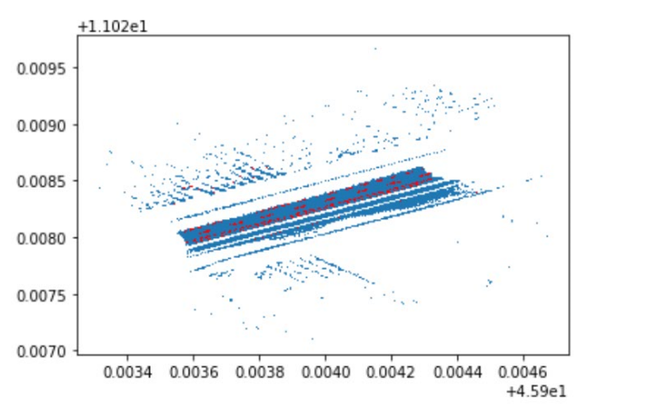
Approach
Points with intensity levels greater than or equal 75 :

Slide 8
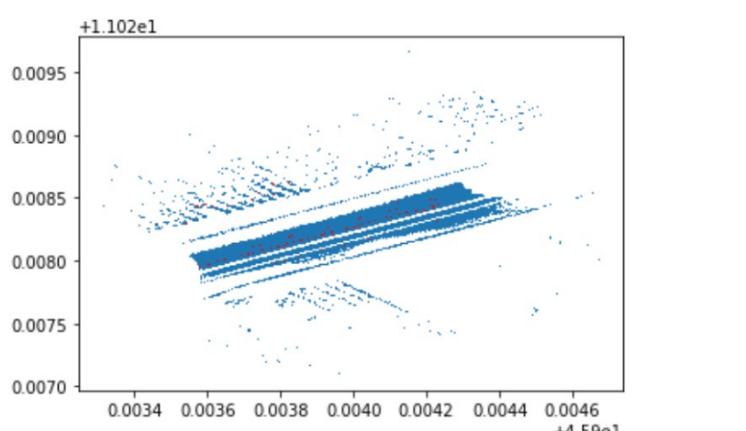
Approach
Points with intensity levels greater than or equal 90 :

Slide 9
Approach
k-means algorithm:
Group the result from last step into three lanes with the k-means algorithm in a 3D coordinate system.
An unsupervised Machine learning algorithm used to cluster points having similar features.
We apply K-means clustering algorithm to each group of line segments.
The output give us an idea about the shape of the lane.
The cluster inside each group would be the required output for the lane boundaries in the image.

Slide 10
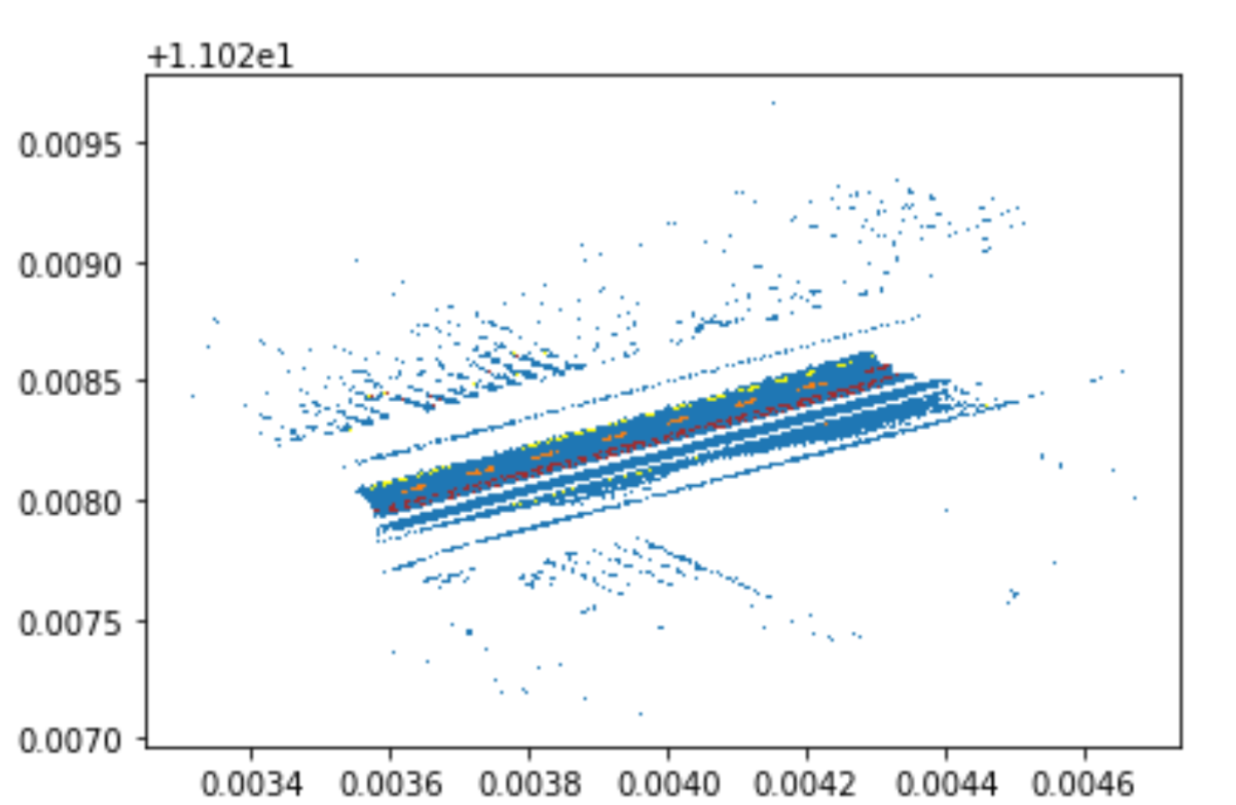
Approach

Slide 11
Approach
RANSAC algorithm:
Fit lines and exclude the abnormal points with the RANSAC algorithm.
RANSAC algorithm is a robust fitting algorithm that has successfully been applied to various computer-vision problems.
The RANSAC algorithm can adapt to the complex conditions of lane estimation of model parameters and it does not need training process compared to the Hough transform and template matching method.

Slide 12
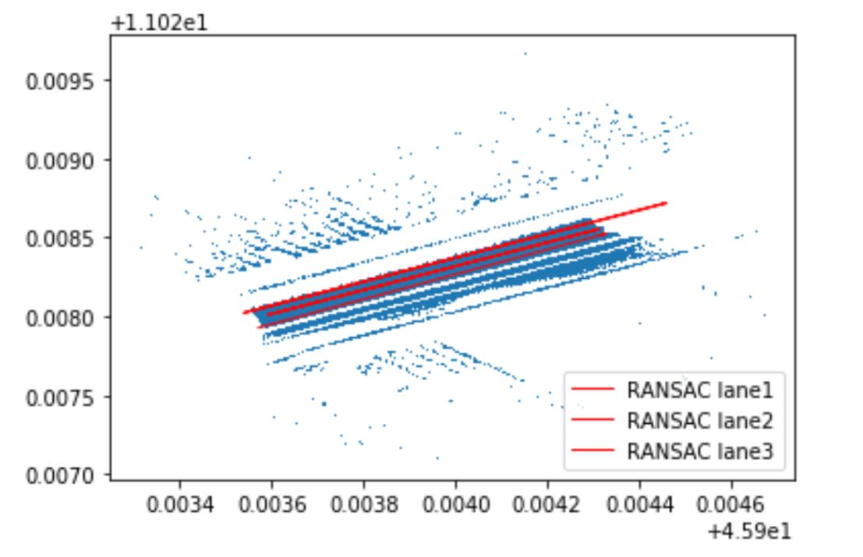
Approach

Slide 13
Future Scope
Future developments of the algorithm may include certain improvements in K-Means with better clustering approximations with a more mathematical basis, better illumination normalization techniques and better noise removal techniques.
The algorithm can be made more robust in marking lanes by using Convolutional Neural Networks on images generated from point cloud data.

Slide 14
Conclusion
The algorithm was developed with the aim of detecting lane boundaries and converting their data into a usable format for further processing in autonomous systems.
This aim has been clearly achieved by this algorithm and thus, can be integrated into autonomous automotive systems for various applications.

Slide 15
References:
Lecture Notes
https://ieeexplore.ieee.org/stamp/stamp.jsp?arnumber=7098273
http://rvsn.csail.mit.edu/Pubs/phd_ashuang_2010feb_laneestimation.pdf
http://www.ingentaconnect.com/contentone/ist/ei/2016/00002016/00000014/art00011?crawler=true
https://www.mi.fu-berlin.de/inf/groups/ag-ki/Theses/Completed-theses/Master_Diploma-theses/2016/Damm/Master-Damm.pdf

Slide 16
Thank You

